Slide 1
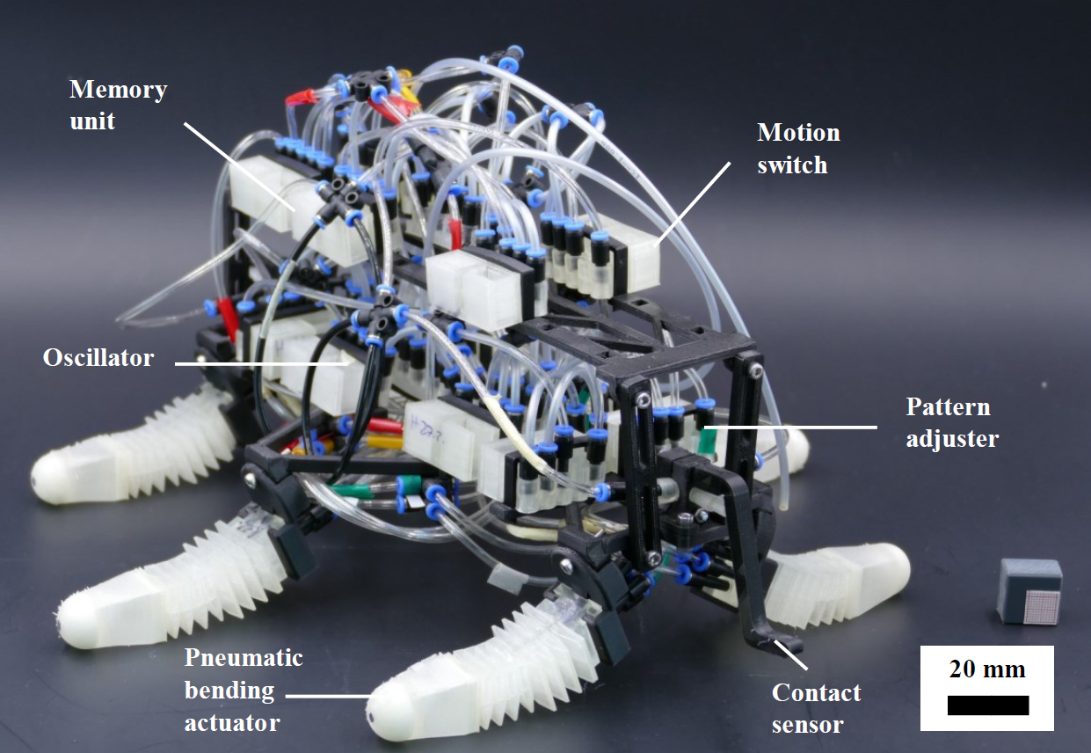
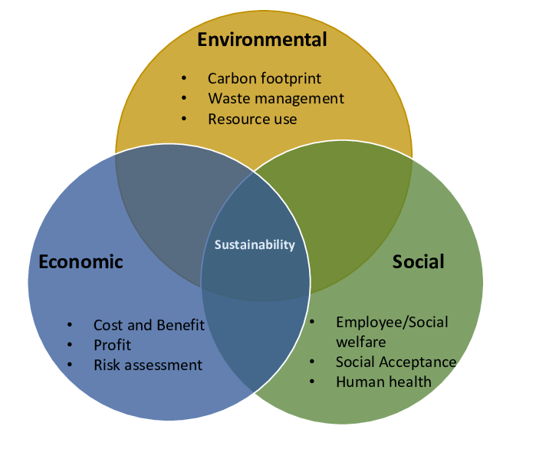
Video (tech-inspired)
Task 1: answer survey scales after watching video:
Perceived Ecological Benefit Scale (PEBS)
Perceived Bioinspiration Scale (PBS)
Random assignment
Welcome and consent
Video (bio-inspired)
Task 2: Task 2: Open text responses on SRW’s contribution to each sustainability pillar (3 text boxes, reflective thinking encouraged)
Task 4: List potential application scenarios of SRW
Task 5: Rate relevance of each scenario (0–2 scale)
Task 3: Evaluation of Communication Format
Example:
Help in case of mining accident
Underwater monitoring
Healthcare
Space exploration
…
Example:
Help in case of mining accident [2]
Underwater monitoring [1]
Healthcare [2]
Space exploration [0]
…
Task 6: answer final survey scales
- General Attitudes Towards Robots Scale (Koverola et al., 2022)
MDMT: Multi-Dimensional Measure of Trust (Ullman & Malle, 2019)
test for knowledge in the robotics domain, previous experience with robots (Neuteboom & de Graaf, 2021)
…

